Slide 1


Gradient coil design code analysis
https://github.com/gBringout/CoilDesign
Ashwini Kumnoor
Research Assistant
Medical Imaging Research Center
Date-24-10-2016

Slide 2
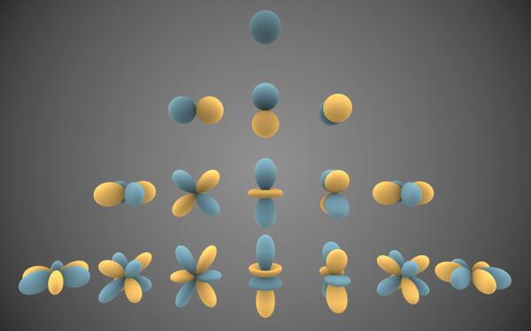
Spherical Harmonics
The spherical harmonics are a complete set of orthogonal functions on the sphere
The spherical harmonics may be organized by (spatial) angular frequency

Slide 3
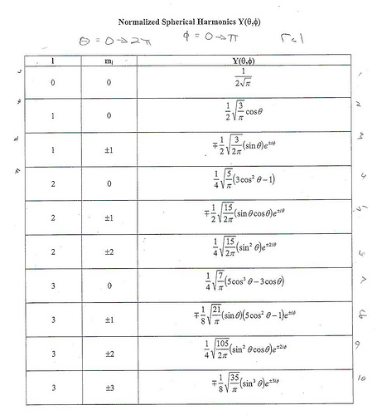

Slide 4
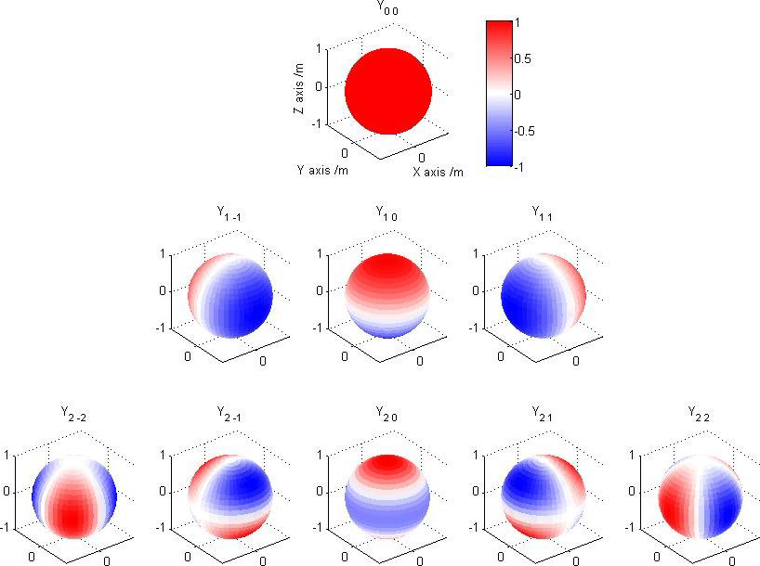
Paper results:

